Slide 1

MES 503 Lab 2
Kayla Blincow, PhD

Slide 2
Announcements
I misspoke on Monday about alpha and p values
Additional reading materials/resources are just FYI (not required)

Slide 3
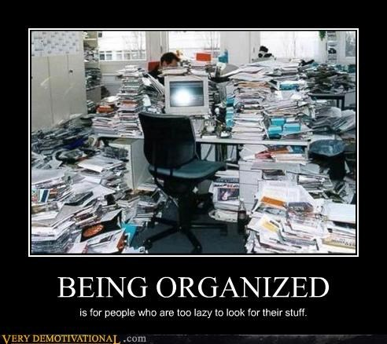
Organizing Ourselves
File Structure
File Naming
Documentation/Comments
Why we must do this
Publishing things takes a long time
GOAL: Future you should be grateful for past you (not angry with past you)

Slide 4


How R integrates with your computer files
You create/edit/import/export files in R: e.g. .csv, .R, .rds, etc.
When you hit save, they automatically get stored in your working directory, which is a file on your computer

Slide 5
How R integrates with your computer files
We need to set up a file structure on our computers that makes sense and then tell R our working directory is within that file structure.

Slide 6
How R integrates with your computer files
We will do this second part using R Projects.
We need to set up a file structure on our computers that makes sense and then tell R our working directory is within that file structure.

Slide 7
Let’s set ourselves up for all our lab things!
Create a folder on your computer to store all your lab materials
Name it something meaningful (e.g. MES503Lab)
Create an R Project within that folder
This will automatically set this parent folder as your working directory
Create a folder for this week’s materials (e.g. Week 2)
Download this week’s materials from Brightspace and store them in your Week 2 folder

Slide 8
Switch to ze code!

Slide 9
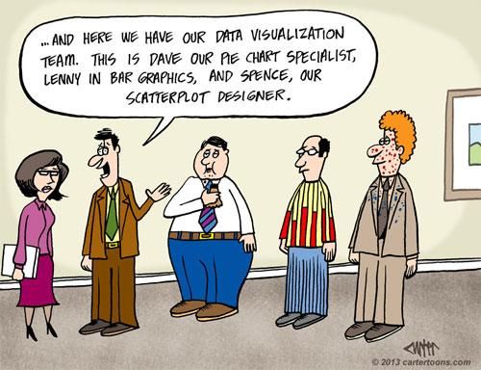
Part 2: Data Viz Continued

Slide 10
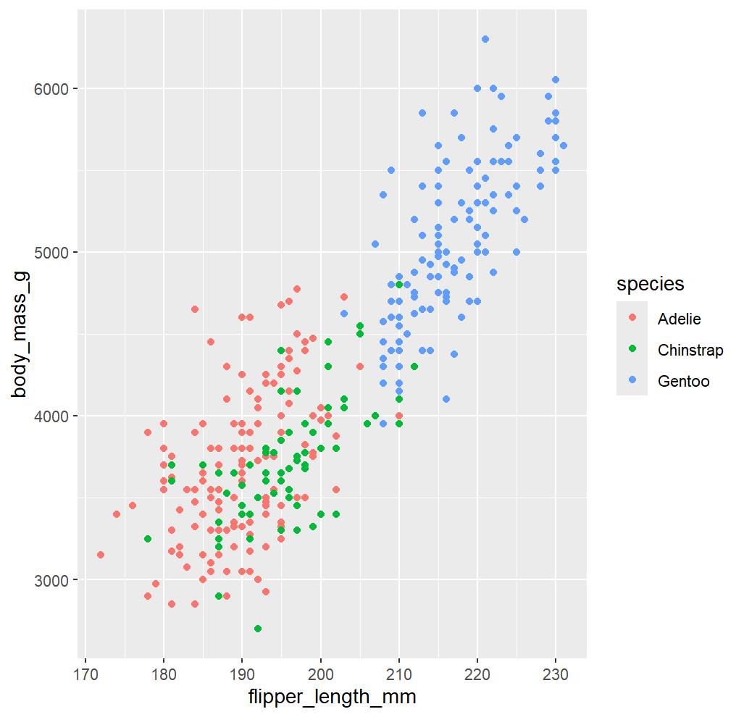
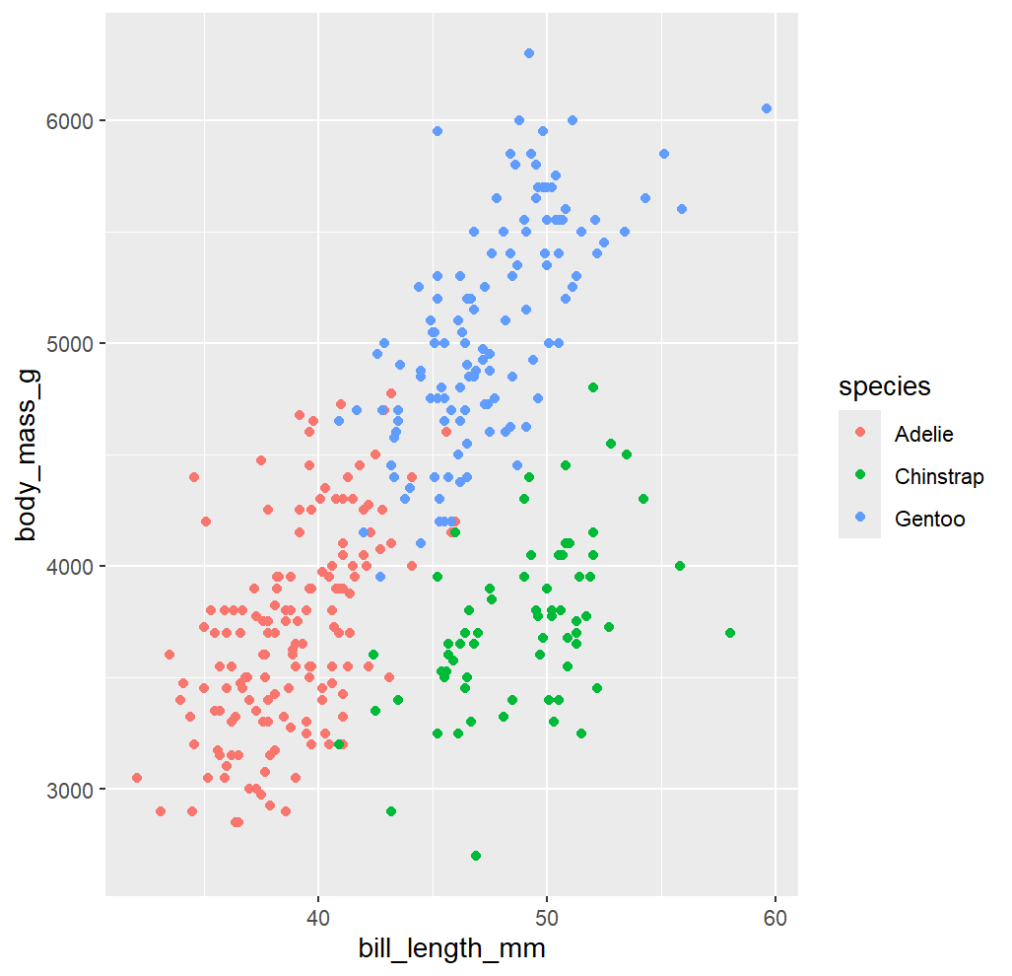
Part 2: Data Viz Continued
Notes:
Last week we made these
Which is a better predictor of body mass, flipper length or bill length? Why?
Humans are really good at pattern recognition. Statistics allows us to assign numbers and quantify relationships that our brains are able to readily see. Because our brains intuitively detect patterns, you should ALWAYS ALWAYS ALWAYS start off by creating a visual to set up your expectation of what you think might happen with the numbers.

Slide 11
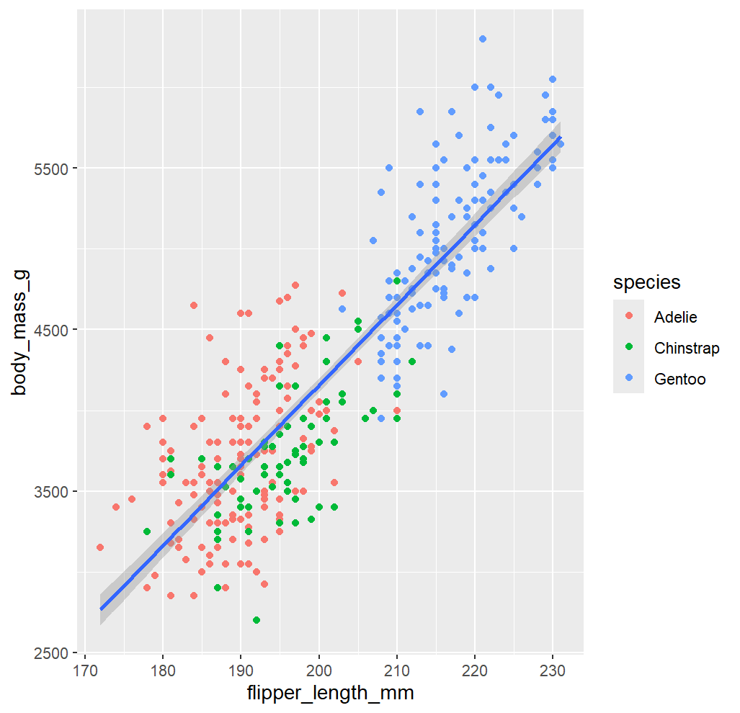
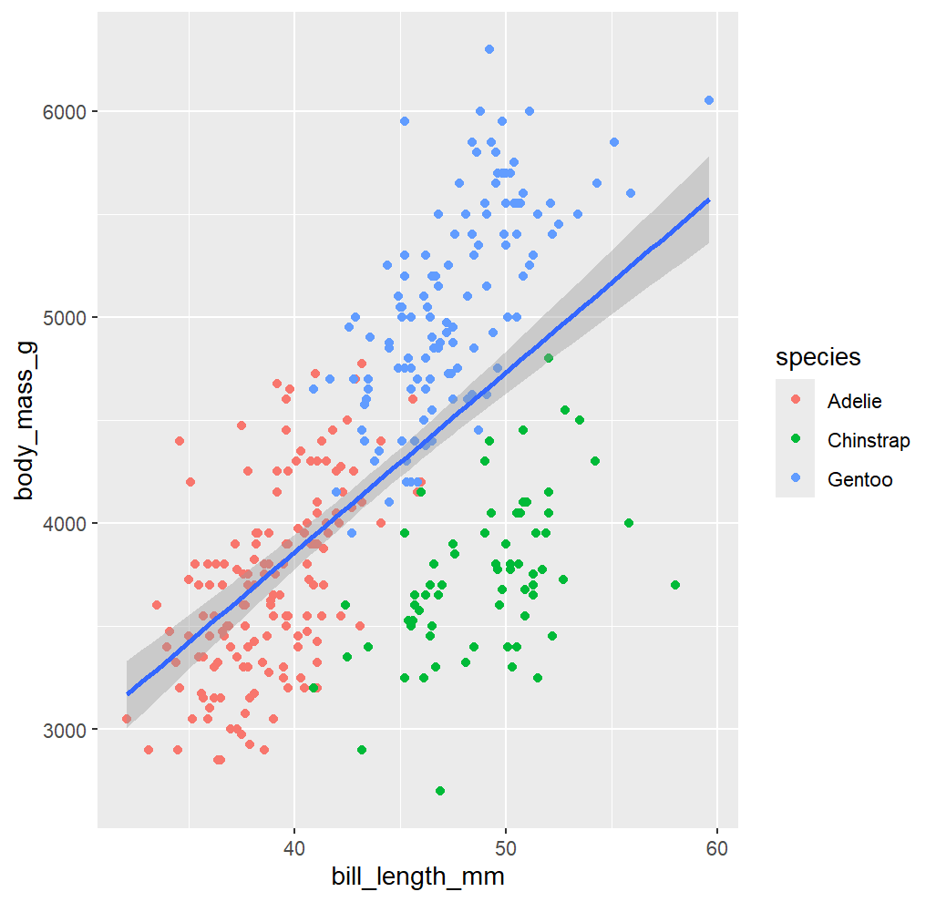
Part 2: Data Viz Continued
p < .001
slope = 49.686 +/- 1.518 SE
p < .001
slope = 87.415 +/- 6.402 SE
Notes:
Last week we made these
Which is a better predictor of body mass, flipper length or bill length? Why?
Humans are really good at pattern recognition. Statistics allows us to assign numbers and quantify relationships that our brains are able to readily see. Because our brains intuitively detect patterns, you should ALWAYS ALWAYS ALWAYS start off by creating a visual to set up your expectation of what you think might happen with the numbers.

Slide 12
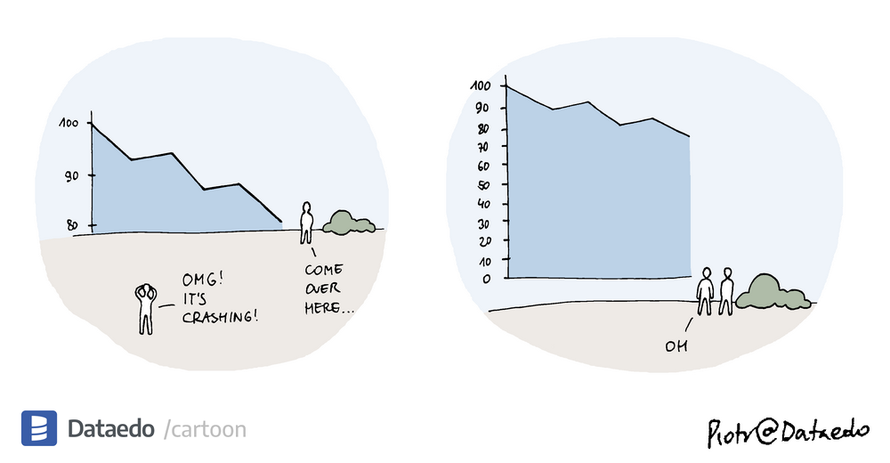
Other reasons data viz is important
It can reveal previously unforeseen relationships
Science communication
Most people are even more confused by stats than you are, and giving them a visual does wonders for communicating your results
It’s fun

Slide 13
Let’s make more visualizations! (and learn more R along the way…)

Slide 14
The data we’ll be looking at…
In an exceptionally dense island population of Hermann's tortoises in Lake Prespa in North Macedonia, sexually coercive males dramatically overnumber females, inflict severe copulatory injuries and put them at risk of fatal falls from the island plateau's sheer rock faces. Harassed females are emaciated, reproduce less frequently, produce smaller clutches and have lower annual survival rates compared to females from a neighbouring mainland population. Sixteen years of capture-recapture data reveal an ongoing extinction event and predict that the last island female will die in 2083.

Slide 15
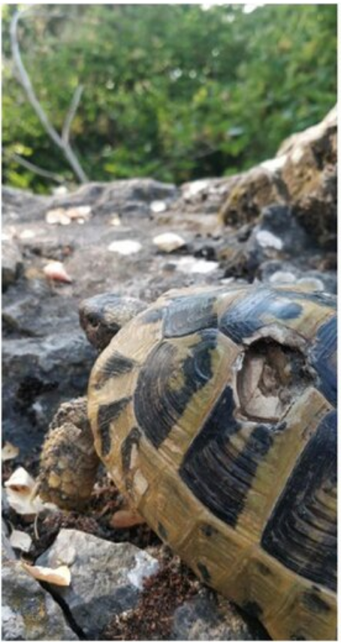
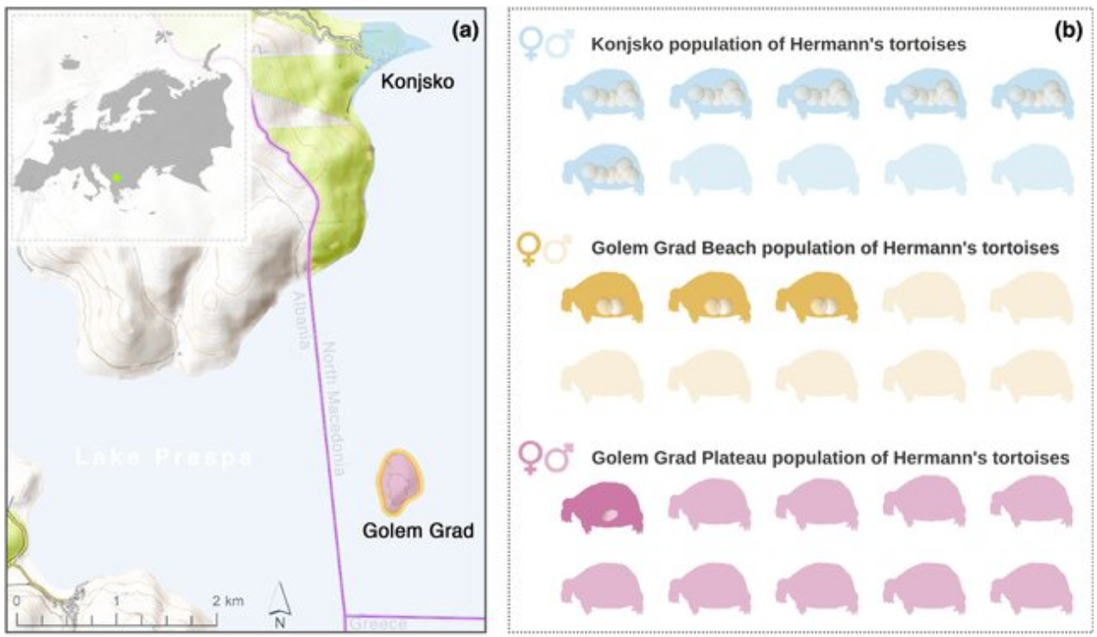
Hermann’s Tortoises
Arsovski et al. (2026) Ecology Letters

Slide 16
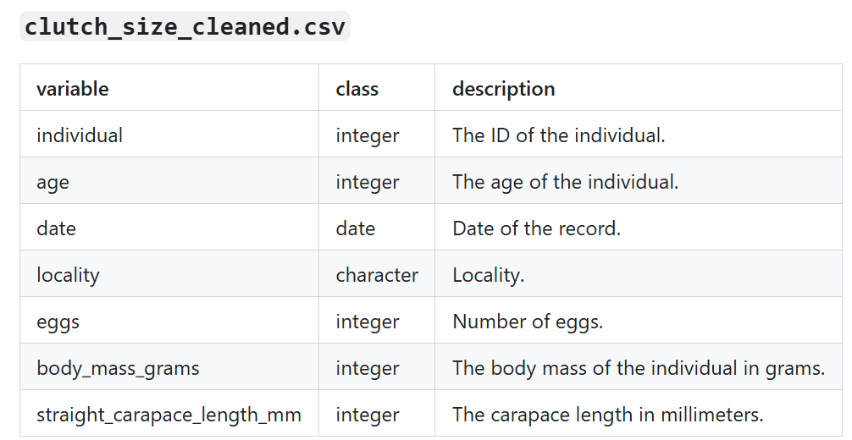
Hermann’s Tortoises Data

Slide 17
Switch to ze code!

Slide 18
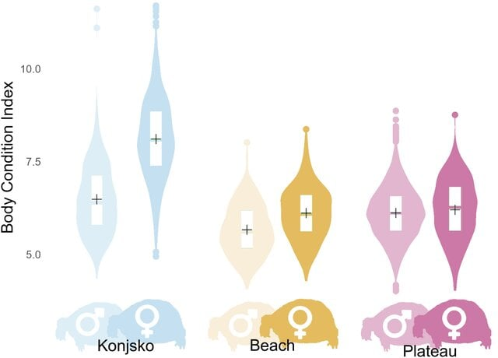

Slide 19
Additional Resources
Data visualization tips for clear communication | Geckoboard
The R Graph Gallery – Help and inspiration for R charts

Slide 20

R Vocabulary
Working directory
getwd(), setwd()
R Project
Notes:
You’re responsible for keeping things organized

